Slide 1

Iron Reign: Technical Presentation

Slide 2
DeepSpace1(Ambulance)
This device uses rubber bands
to deal a blow to the
ambulance, blasting it into the
yellow zone.

Slide 3
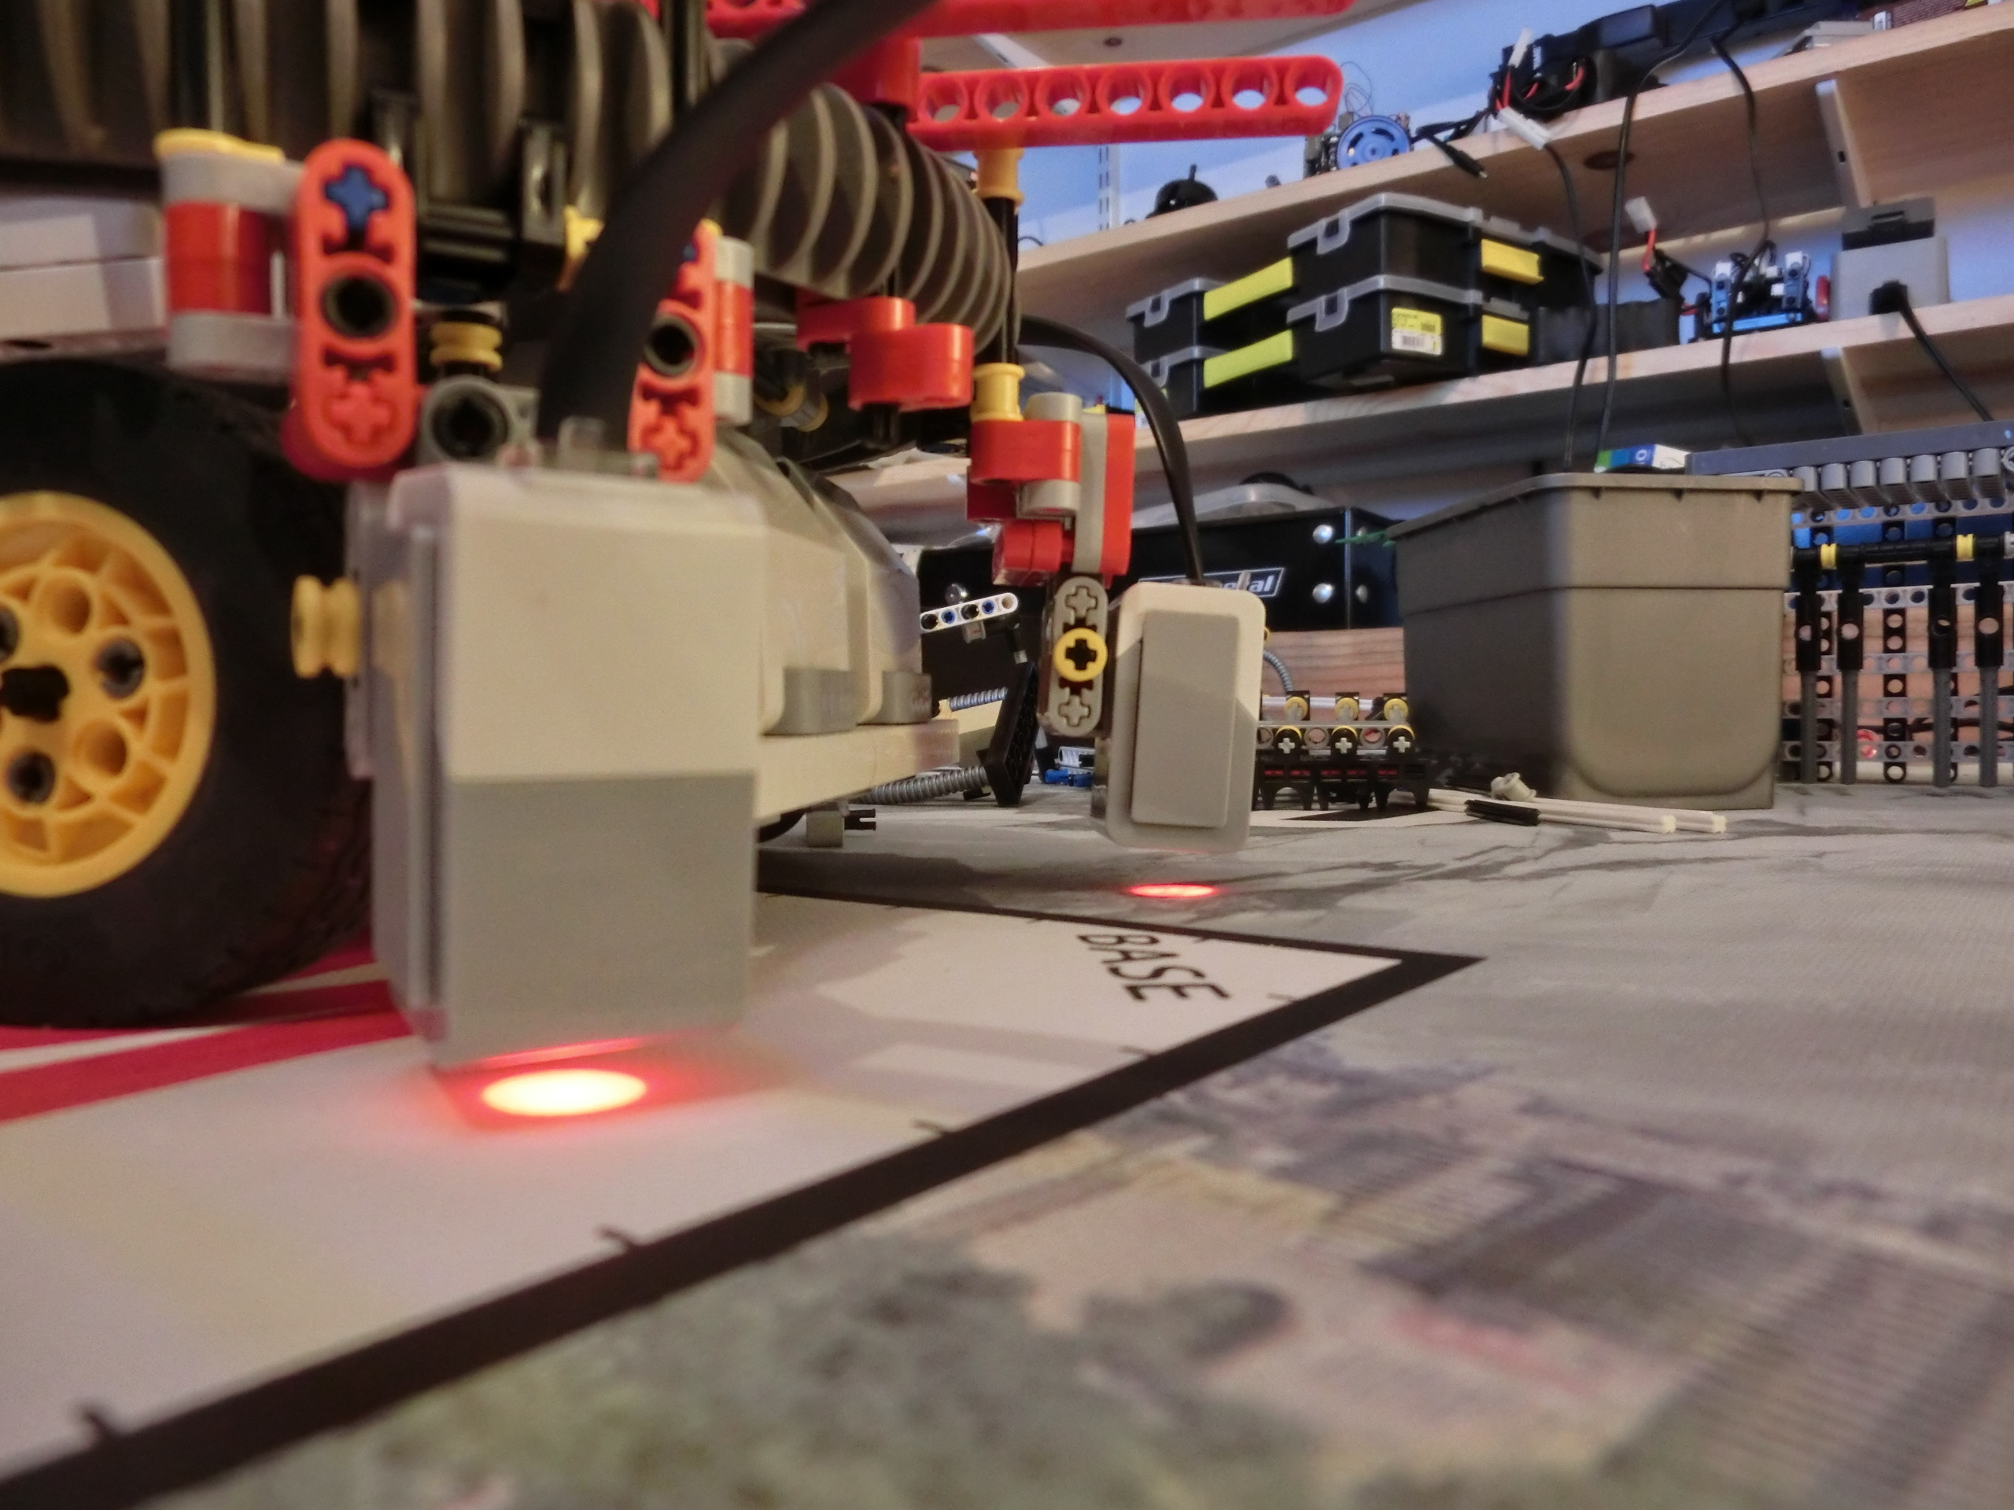
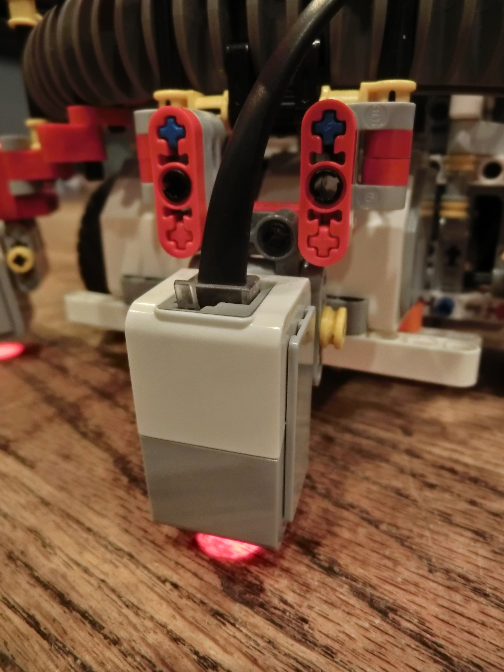
Light Sensors
The light sensors are mounted on the turret, allowing them to spin around as we need.
One light sensor is for color, the other for light

Slide 4
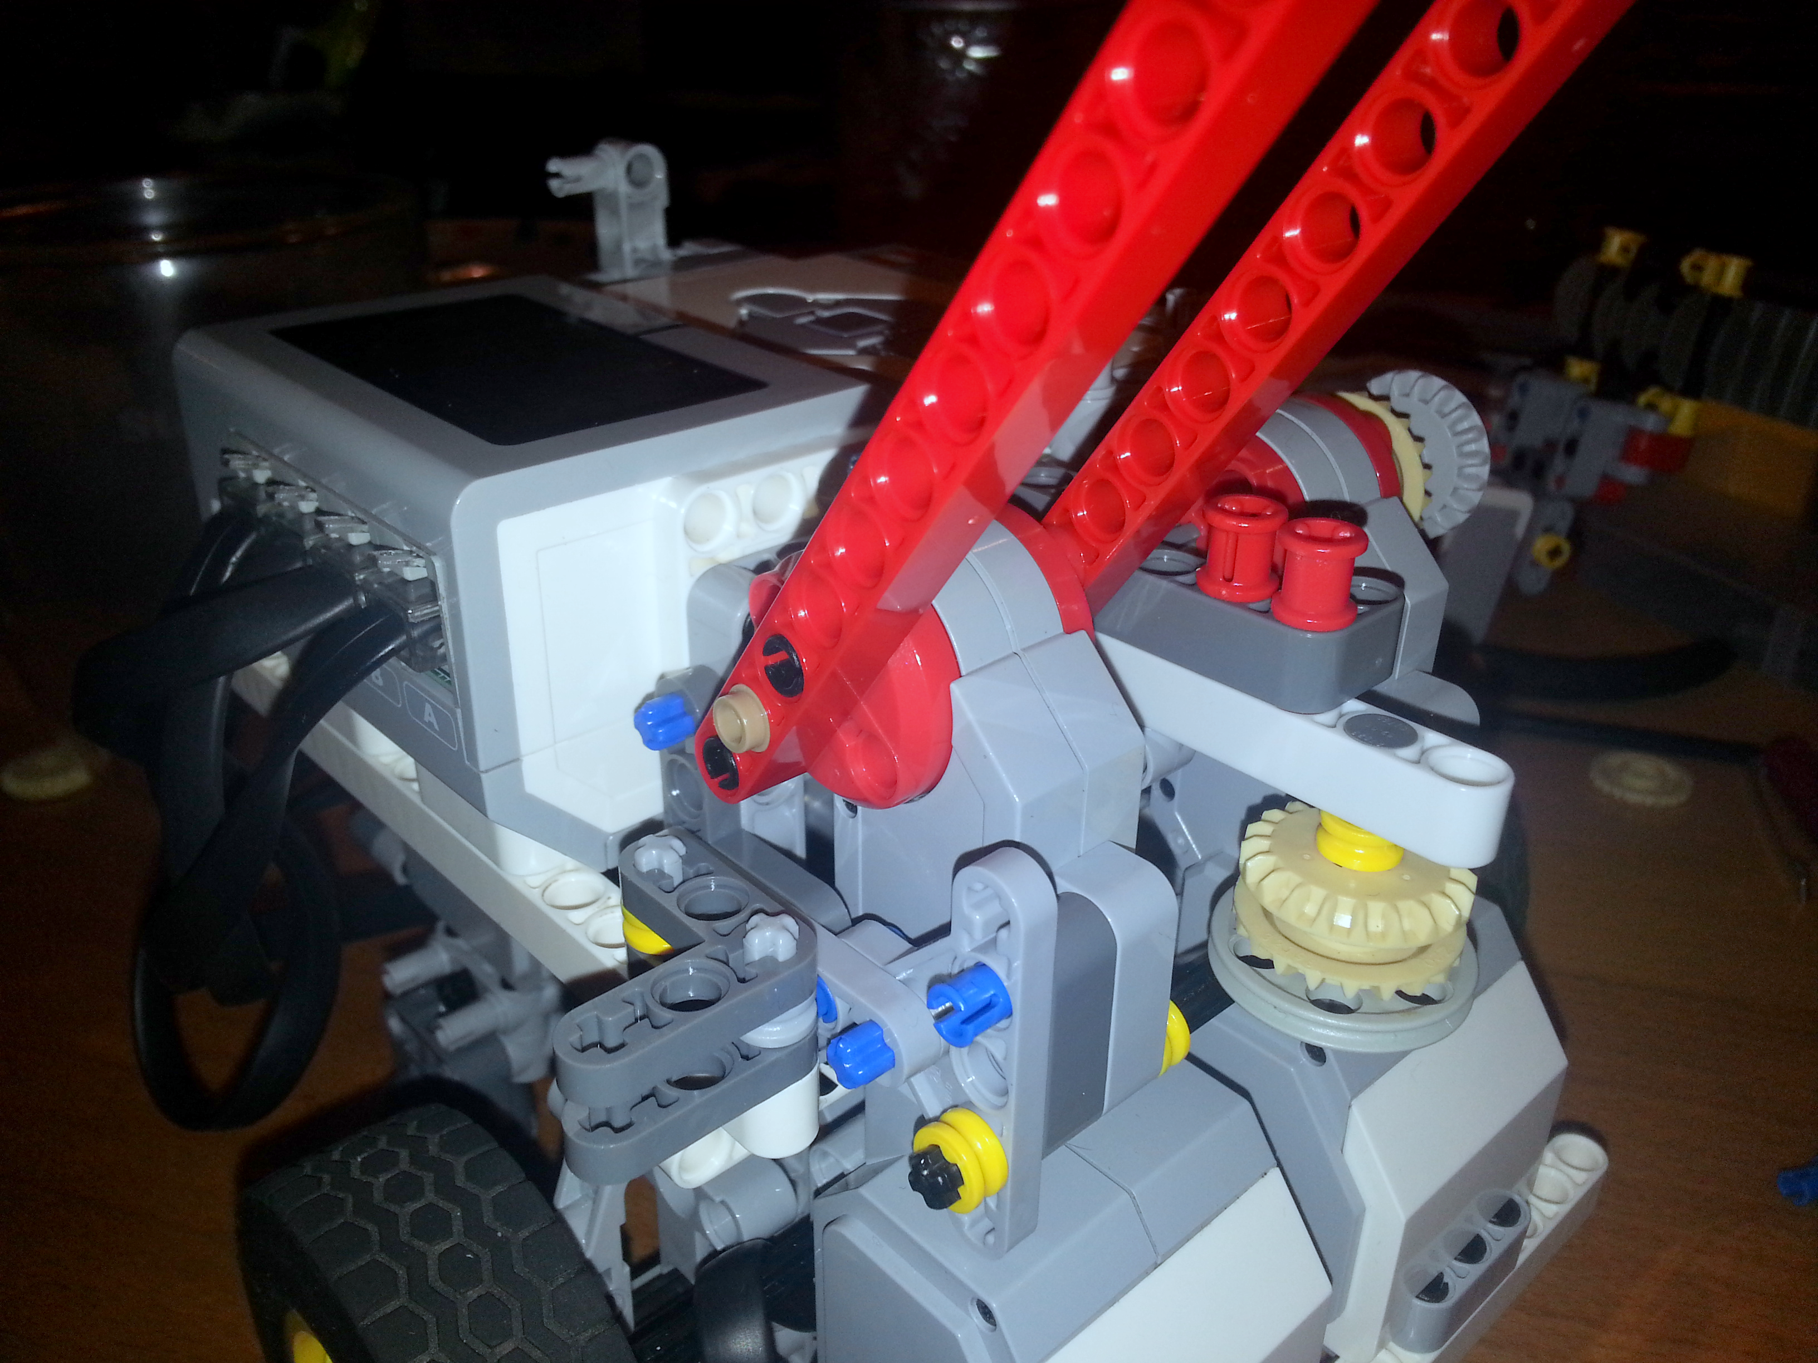
The Arm
The arm is the main point for attachments
It is the most useful part of the robot

Slide 5
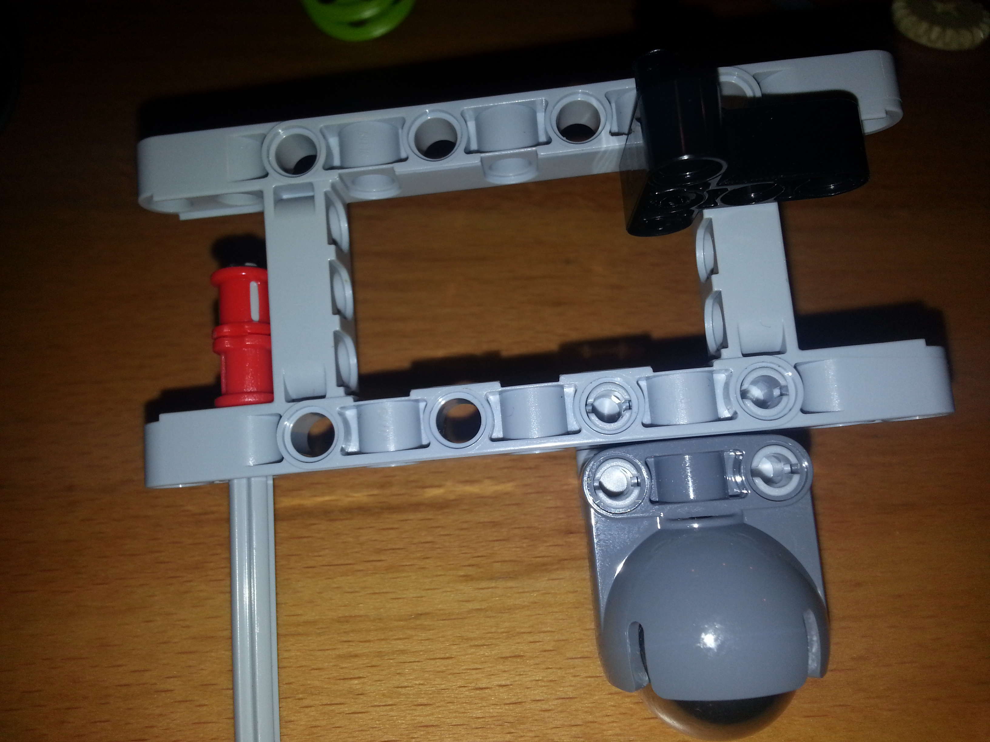
Chassis(Skid Ball)
We use metal ball bearings to
have a free moving back of the
Robot.

Slide 6
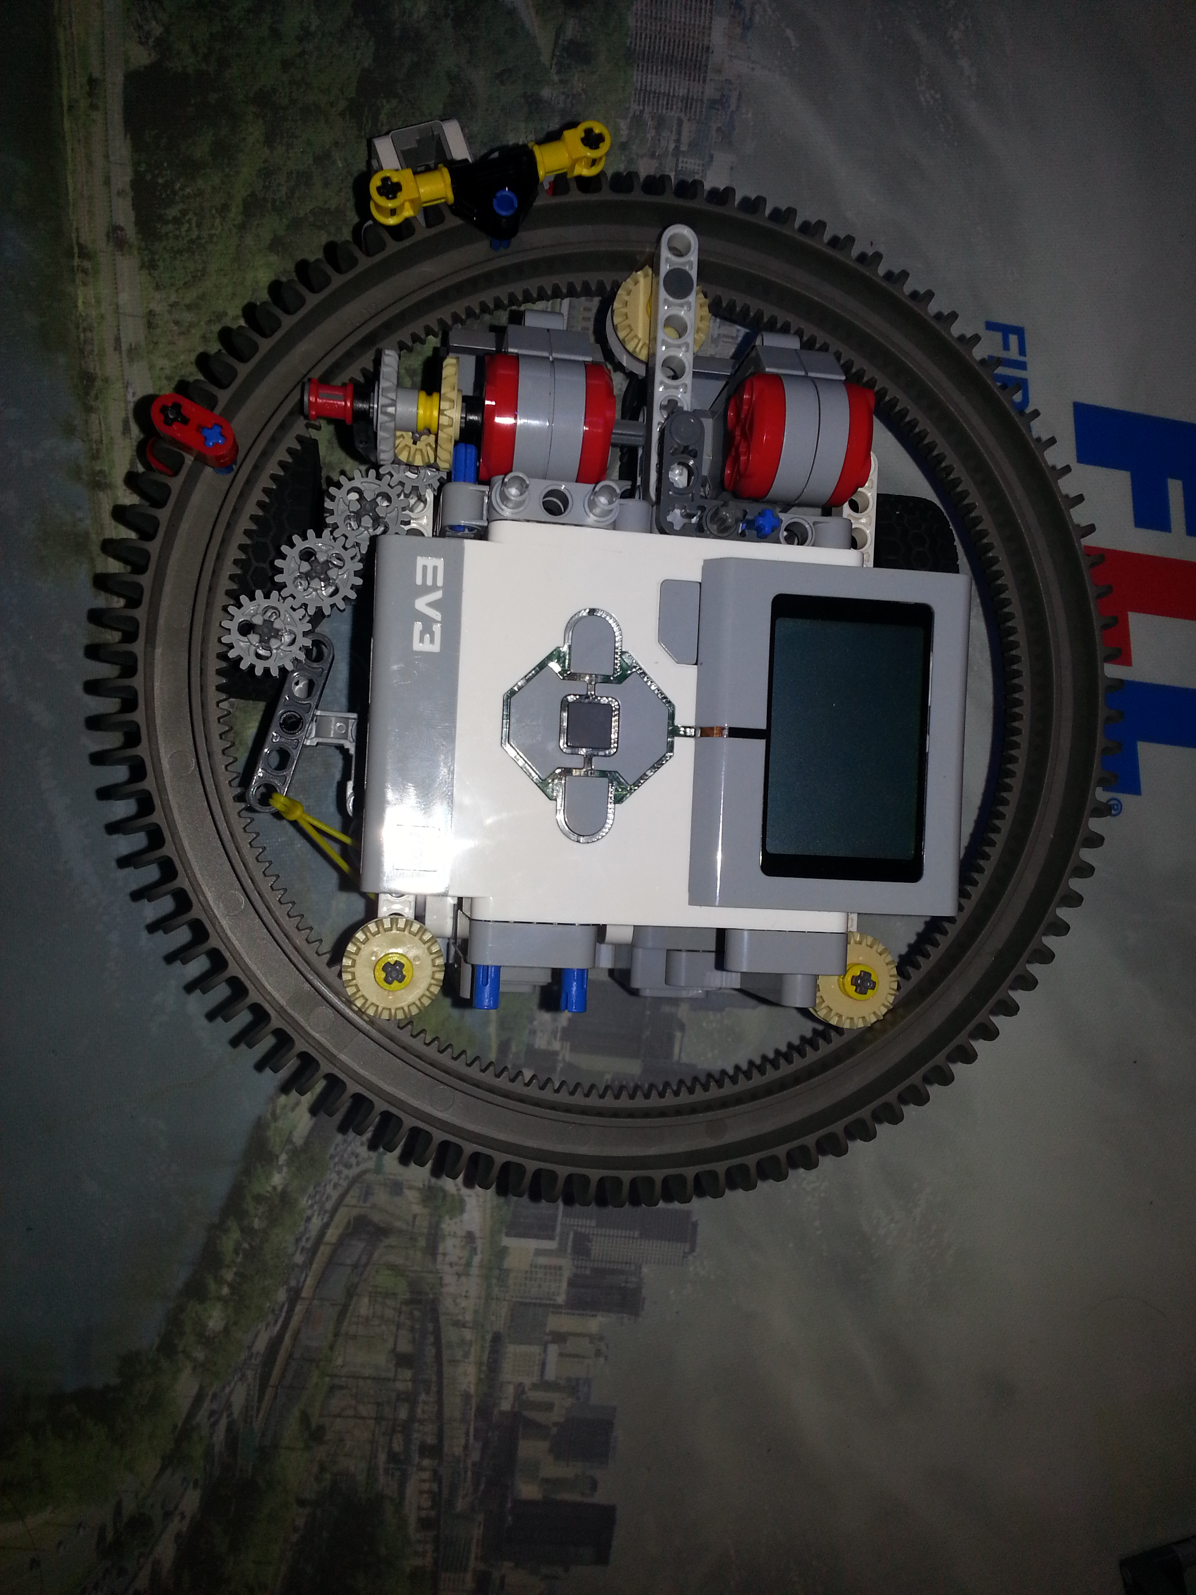
Turret
This wheel surrounds the
robot to make it more
compact and get under
the wire and still hold
attachments.

Slide 7
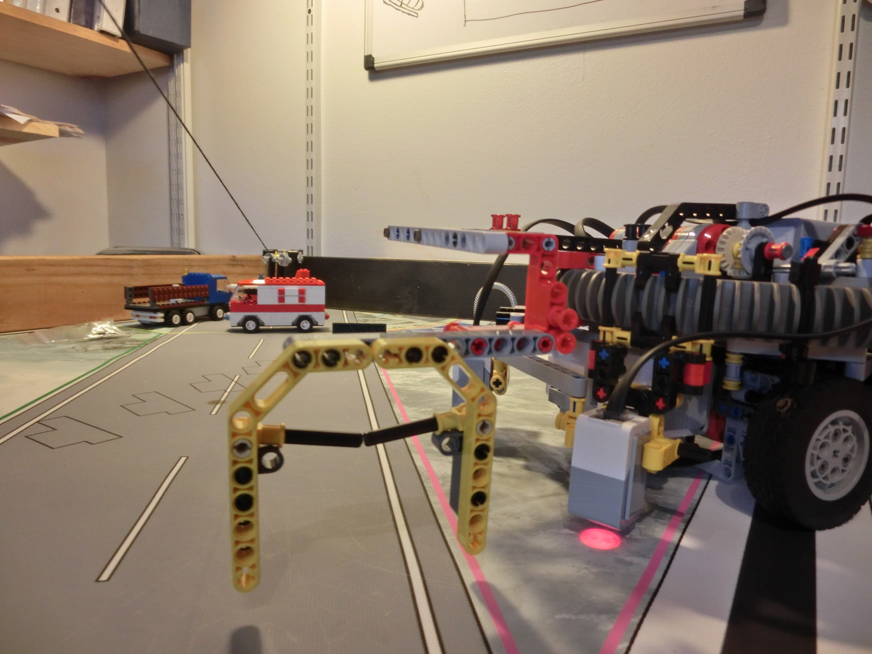
Hoop Pick Up
This attachment only moves in one direction, making it impossible for hoops to fall off.

Slide 8
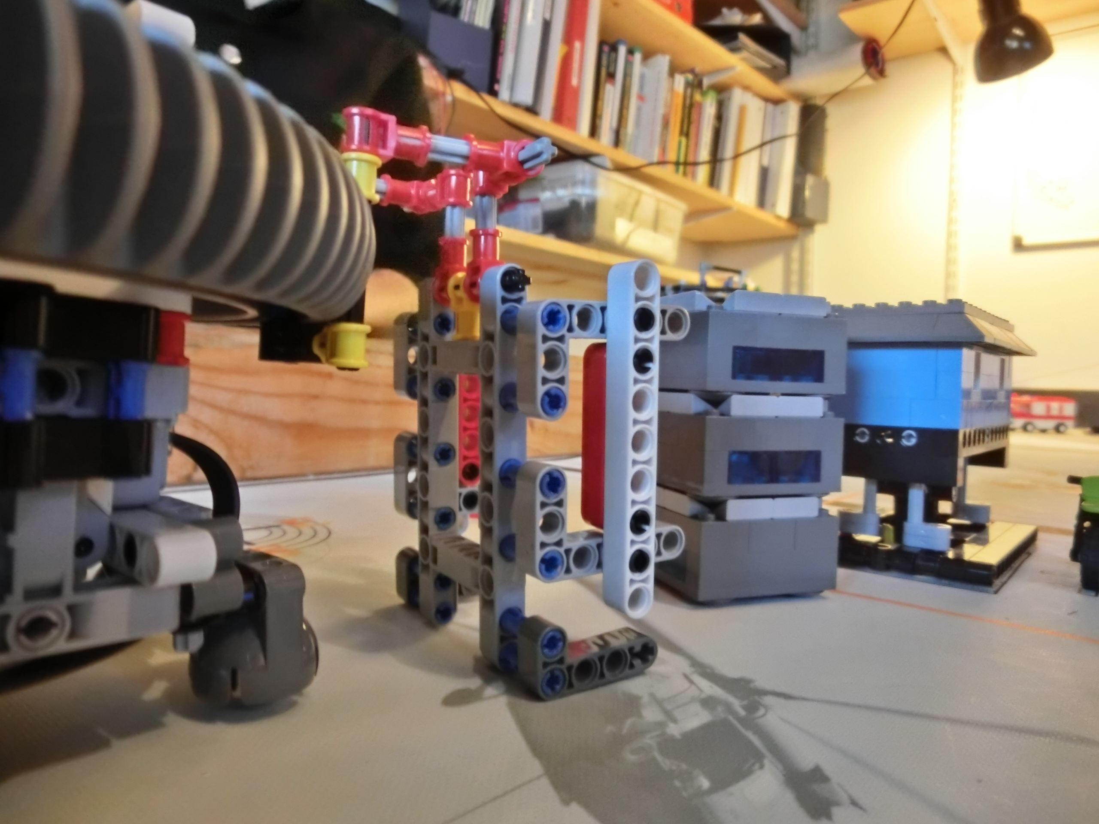
Code Construction
This attachment moves the building to a safer place.

Slide 9
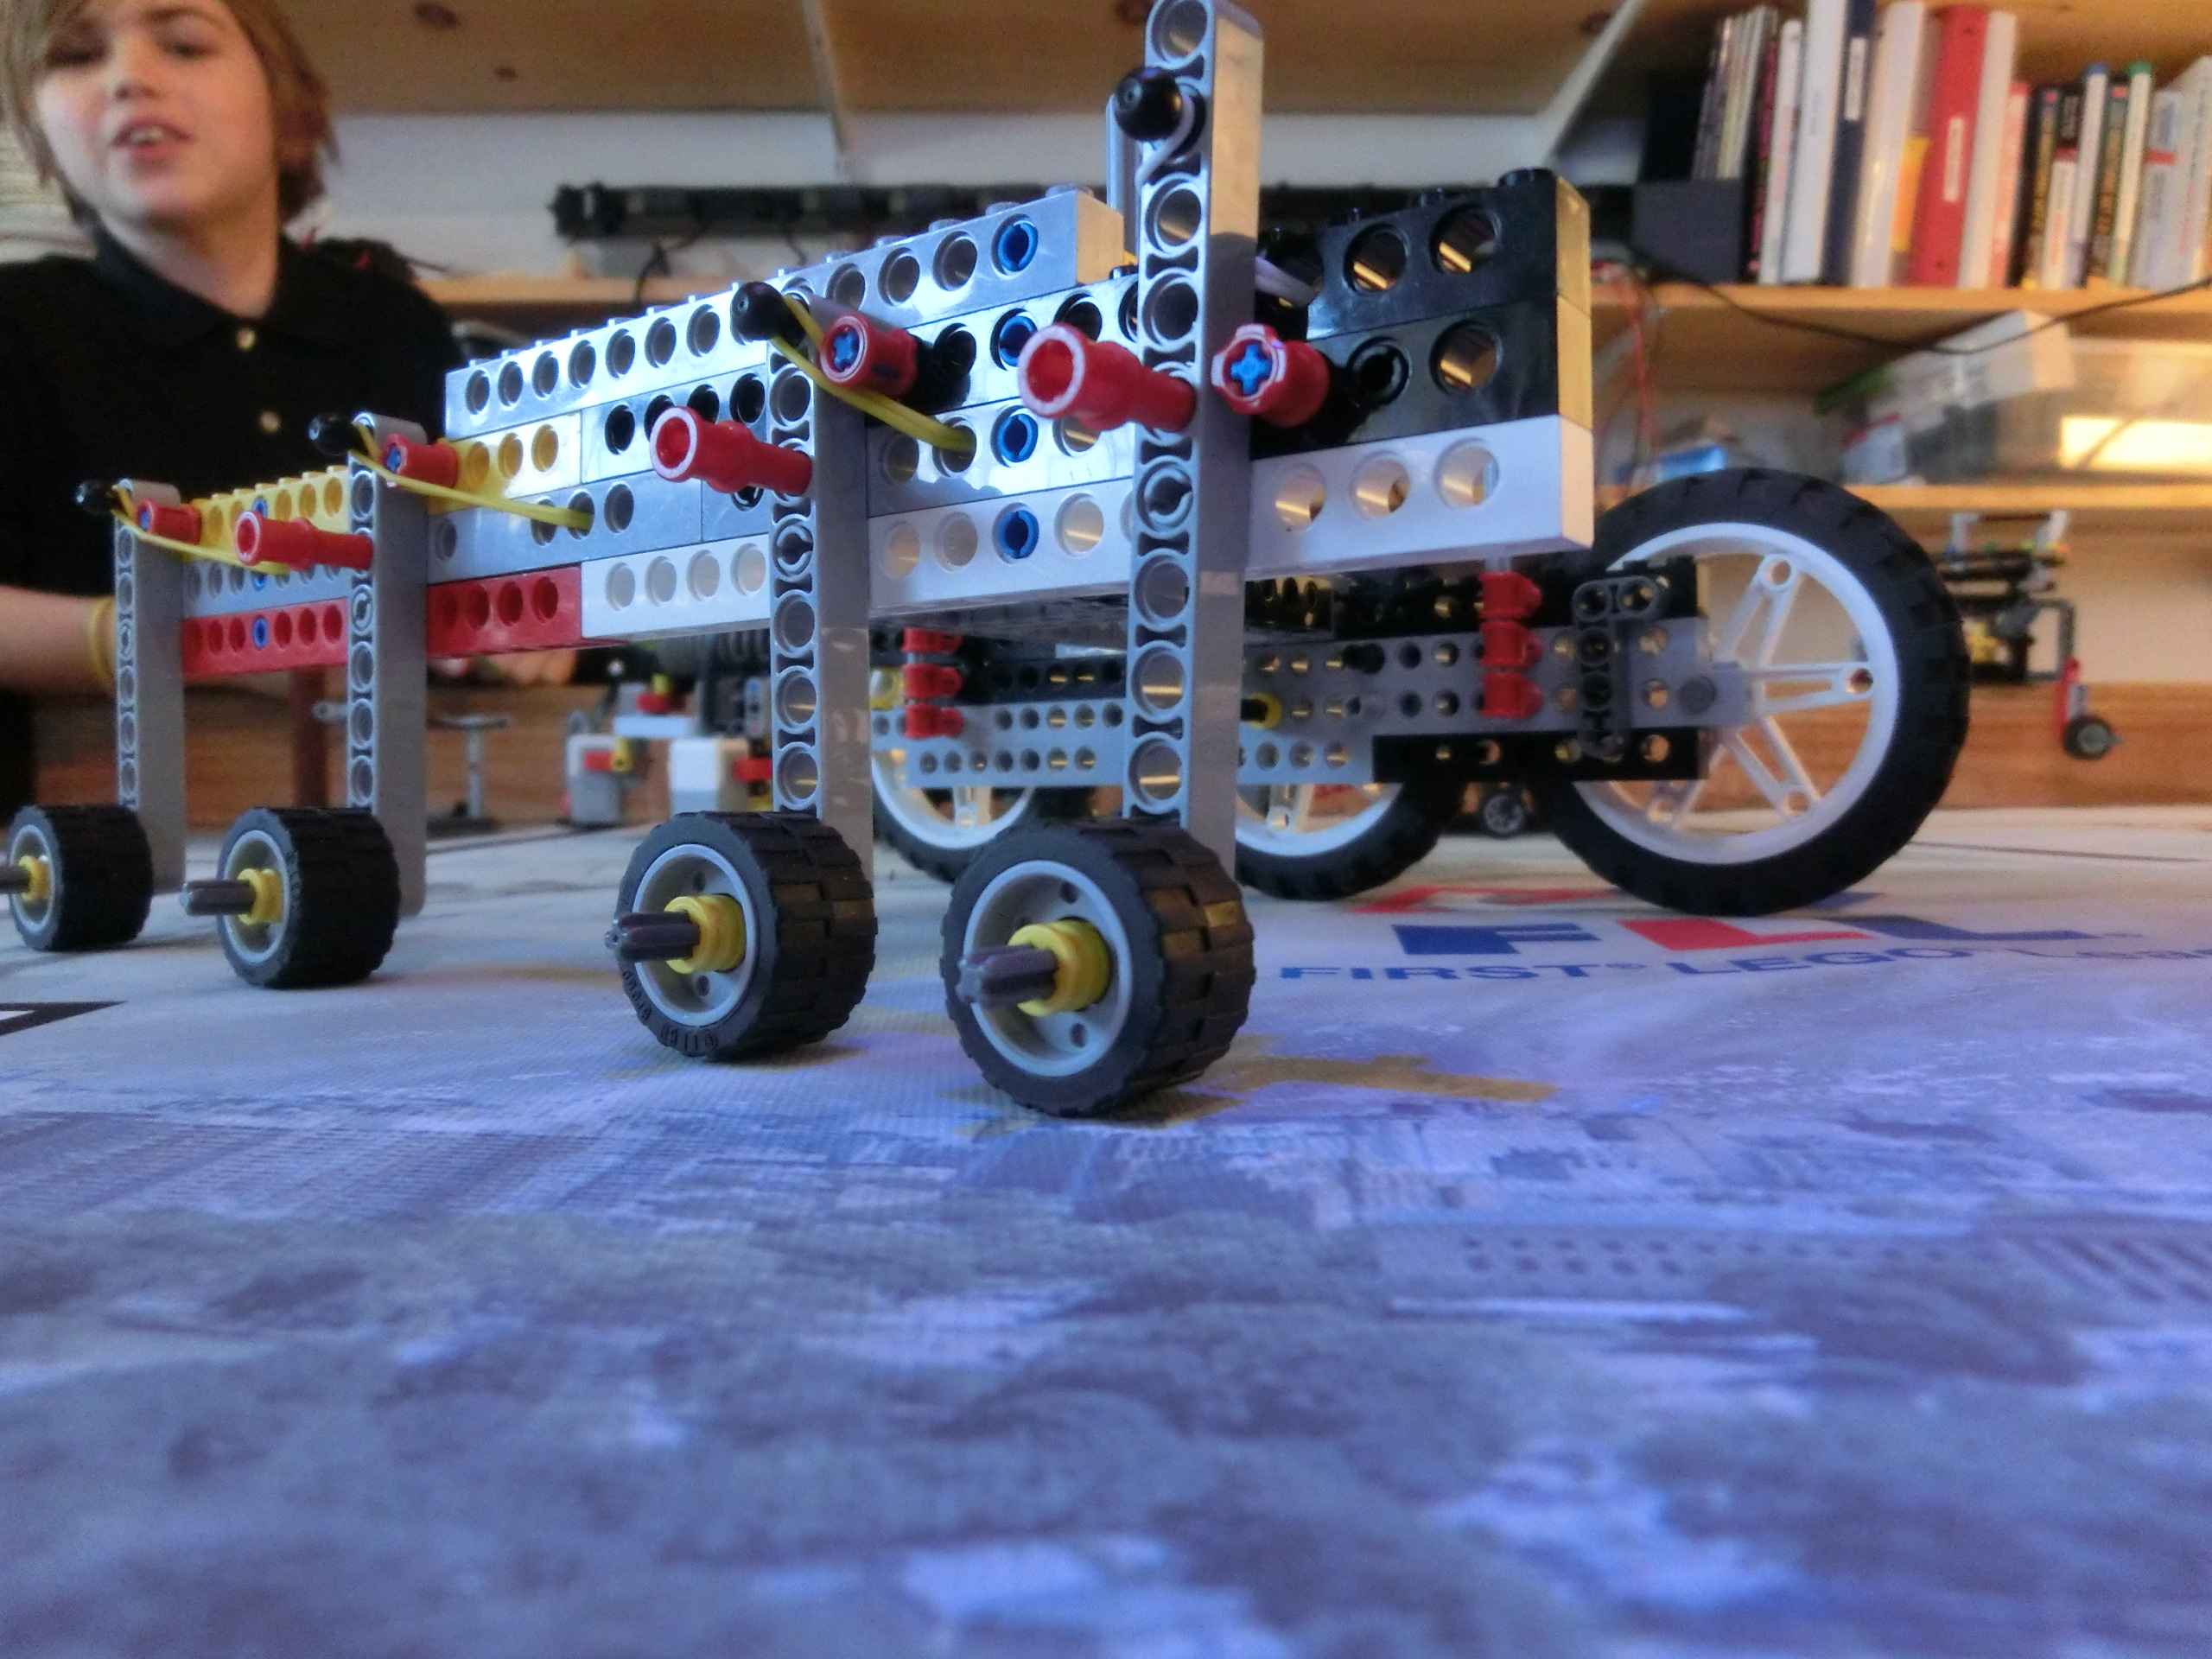
ATR – All Terrain Robot
This attachment goes over the obstacle course by its tires lifting and moving down by the process of rubber bands.

Slide 10
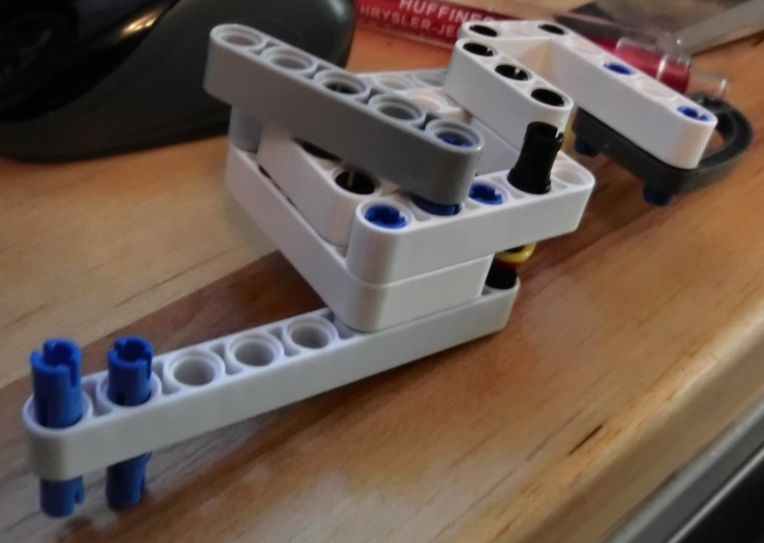
Leaf Whacker
This attachment uses rubber bands as tension to deliver a powerful hit to the tree’s trunk.

Slide 11
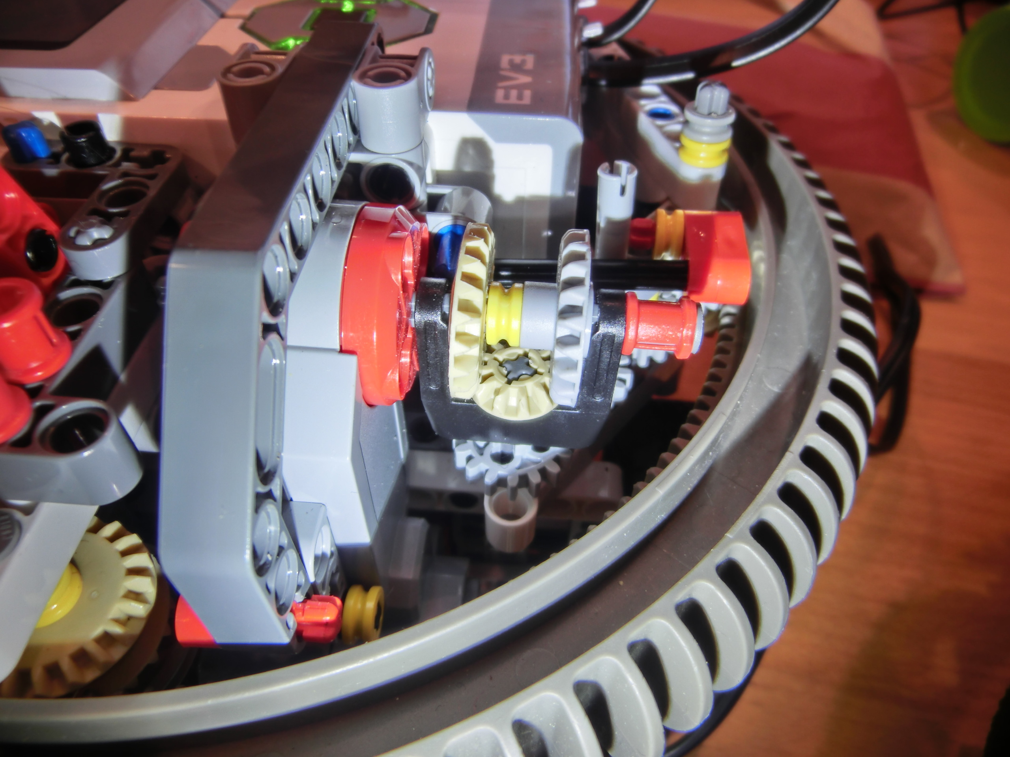
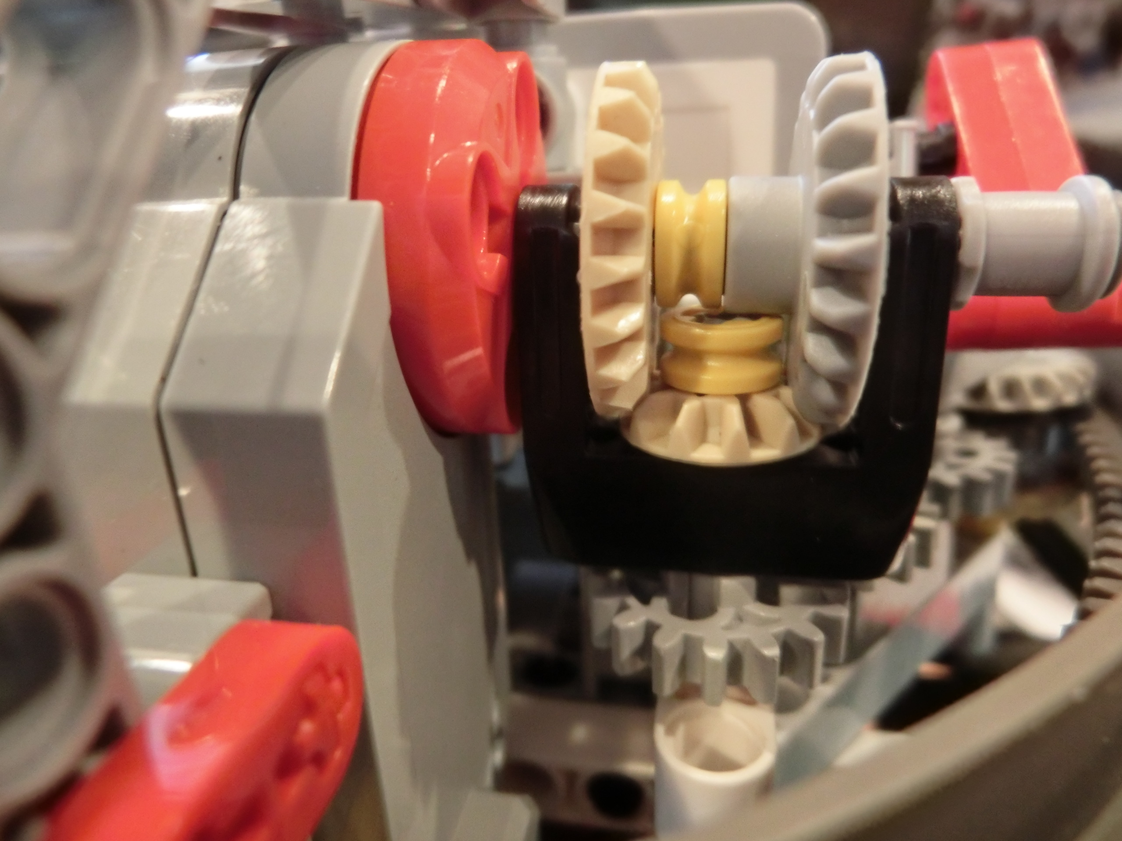
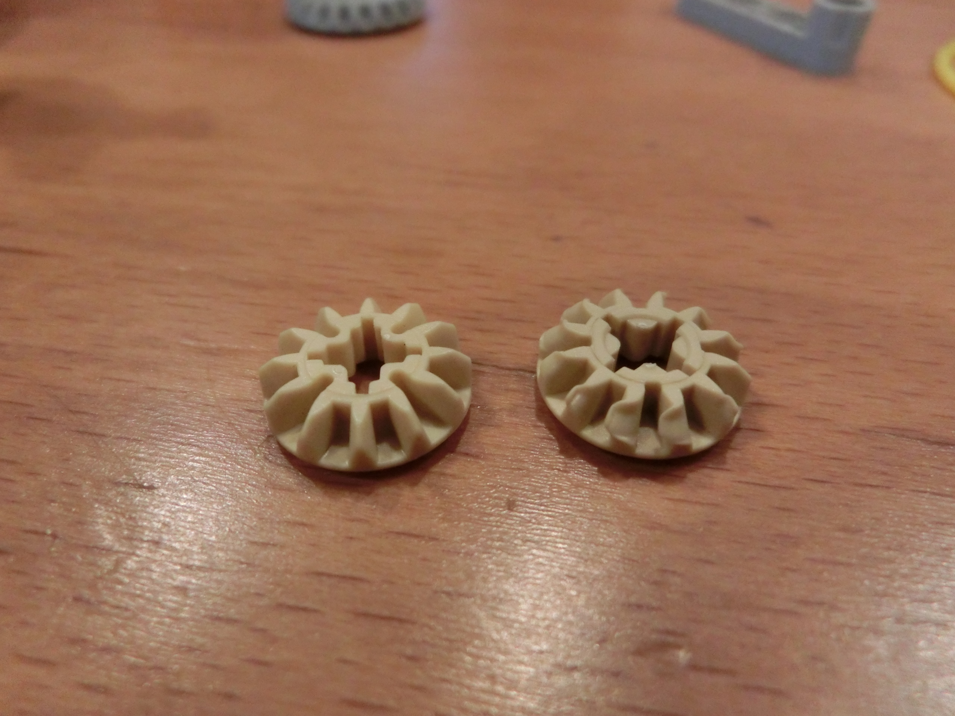
Turret Problems…
Gear after being done with our robot
New Gear

Slide 12
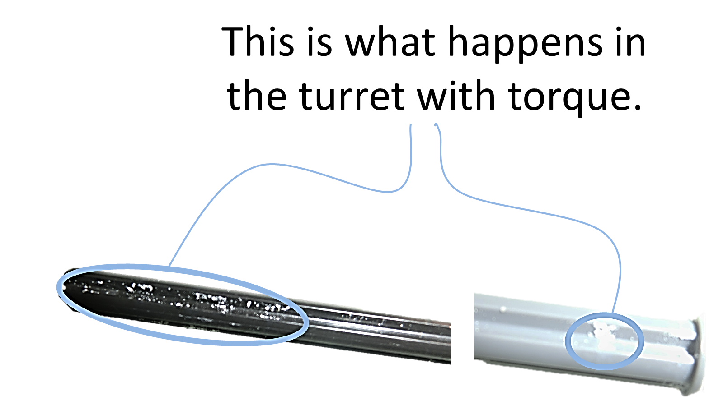
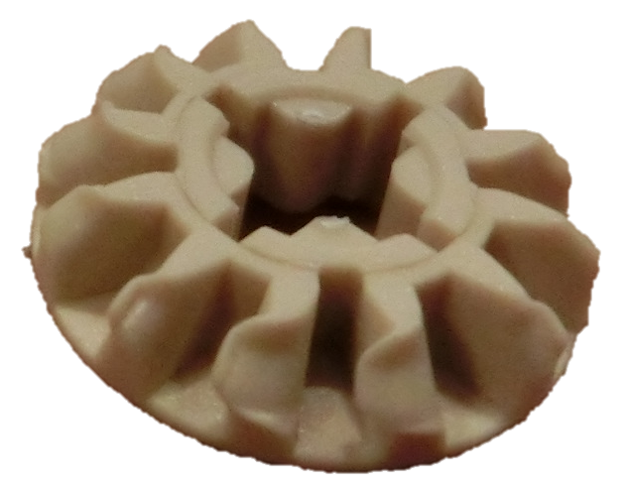
MORE Turret Problems…

Slide 13
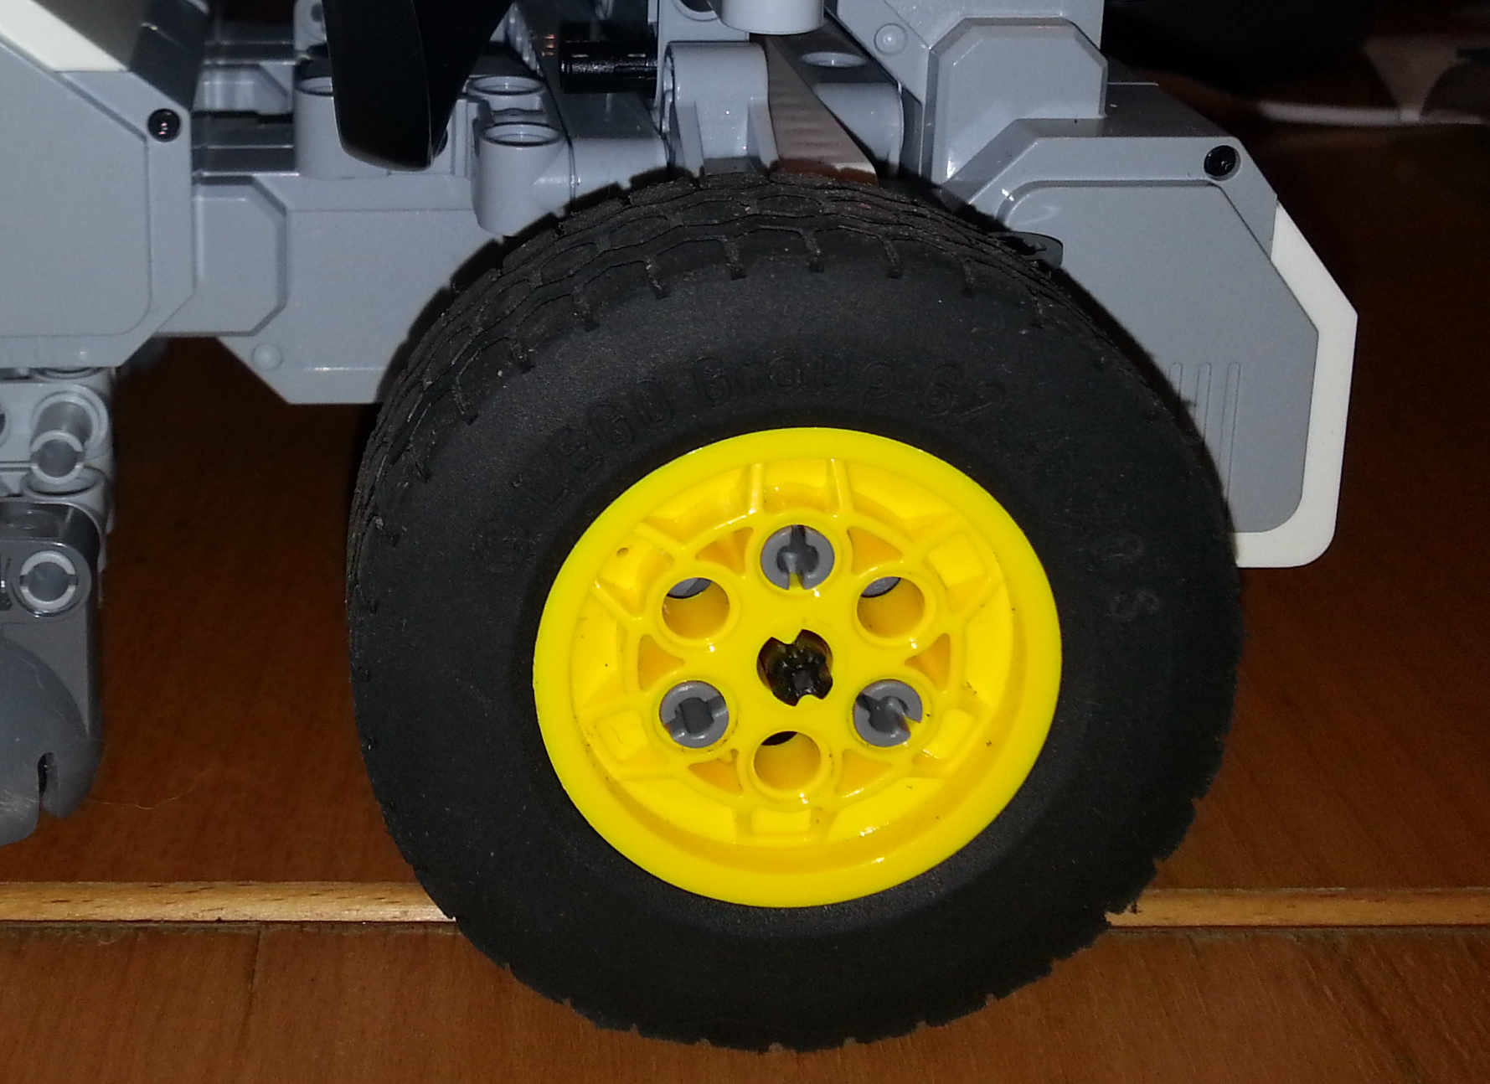
Mobility
We used a type of wheel
that provides a nice amount
of traction and movability.

Slide 14
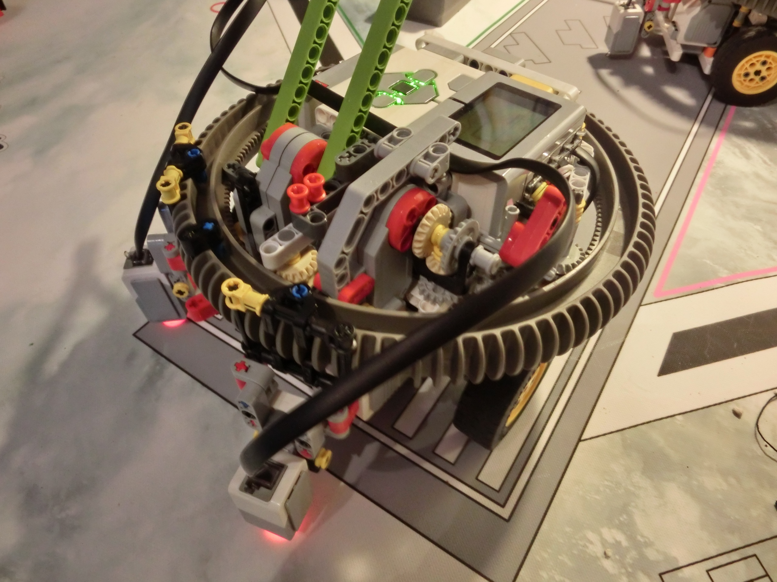
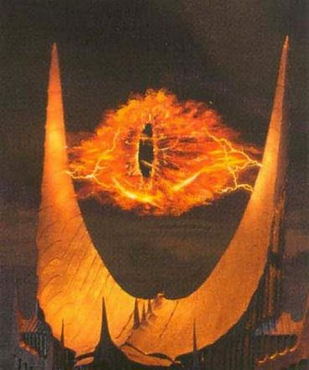

Final Robot
The final result of this is the
low down, compact, light sensor
swinging, killer robot. It is the way
we compressed all the important
things like motors and sensors that
make it work.
I Return to
Mordor

Slide 15
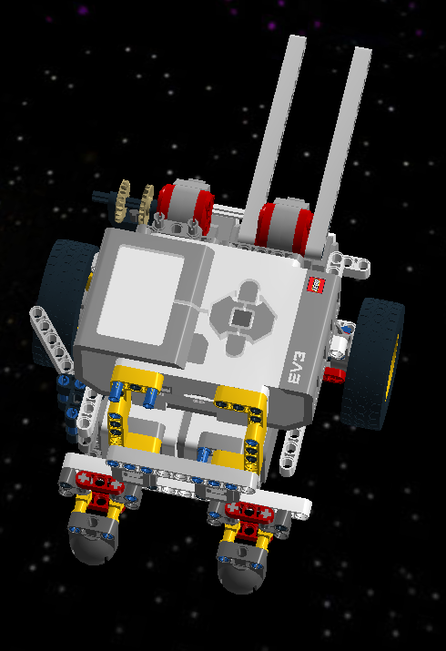
Design

Slide 16
Core Programs

Slide 17
Code Metrics
51 Variables
32 MyBlocks
16 Programs
6 Mission runs
Over 300 blocks

Slide 18
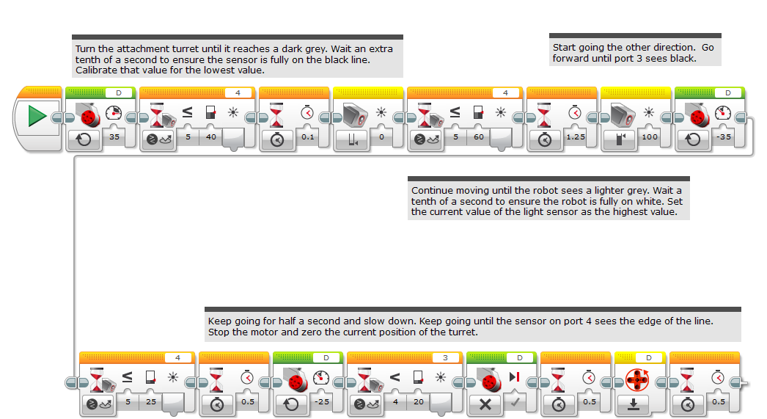
Color4

Slide 19
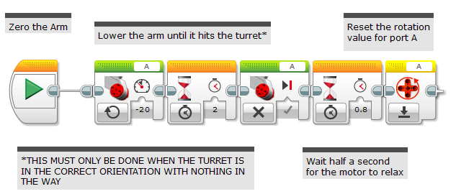
Zero Arm

Slide 20
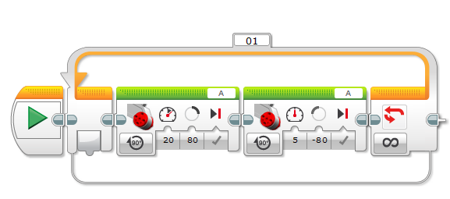
Zero Arm

Slide 21
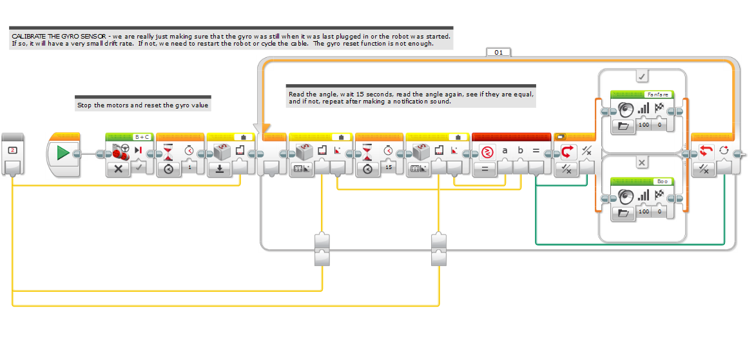
GyroCal

Slide 22
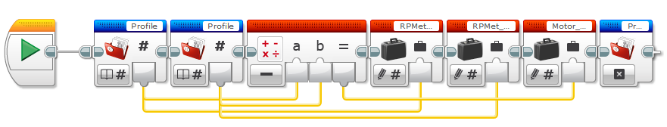
Init_Odom

Slide 23
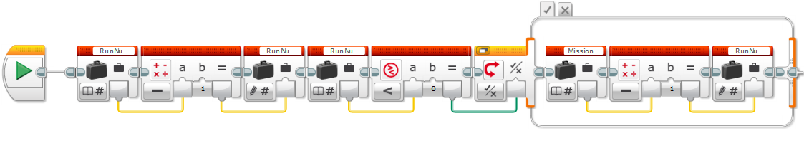
RunMinus

Slide 24
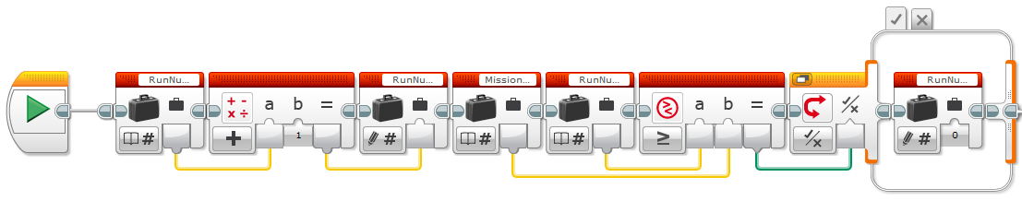
RunPlus

Slide 25
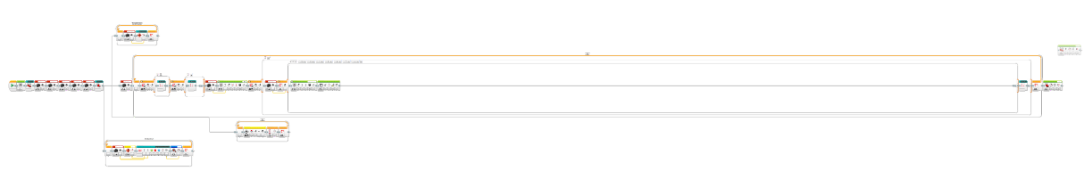
_Game

Slide 26
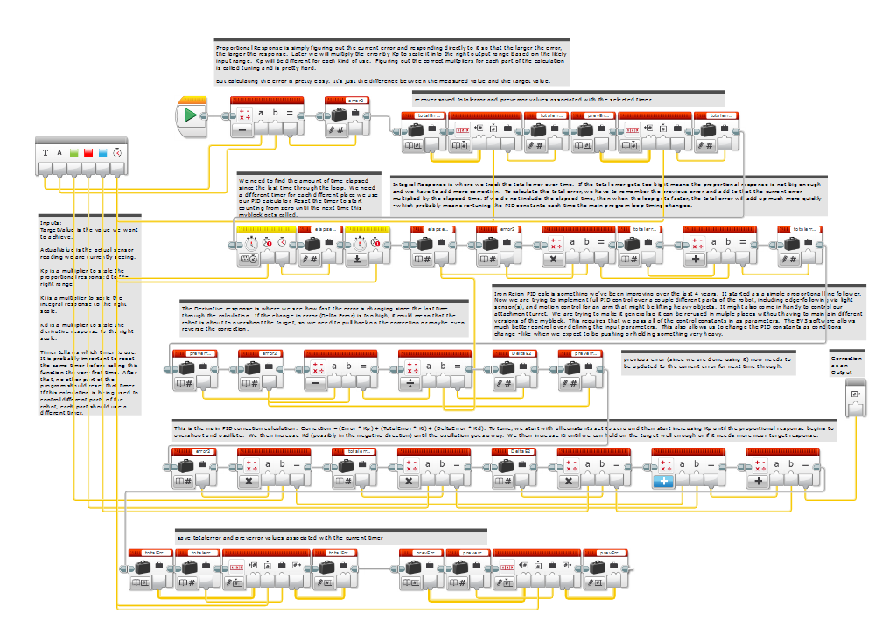
IR_PID_Calc_Multi2

Slide 27
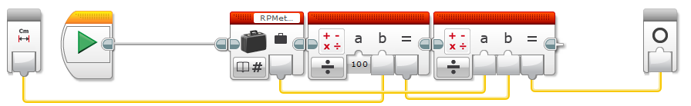
Distance_Calc

Slide 28
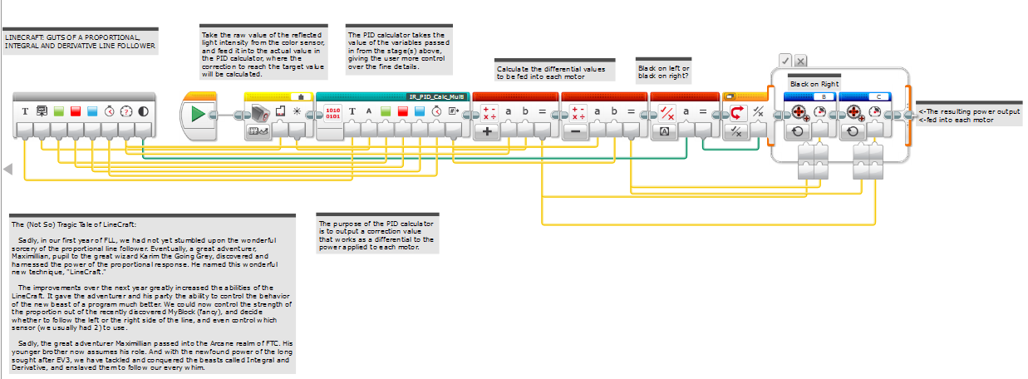
Linecraft

Slide 29
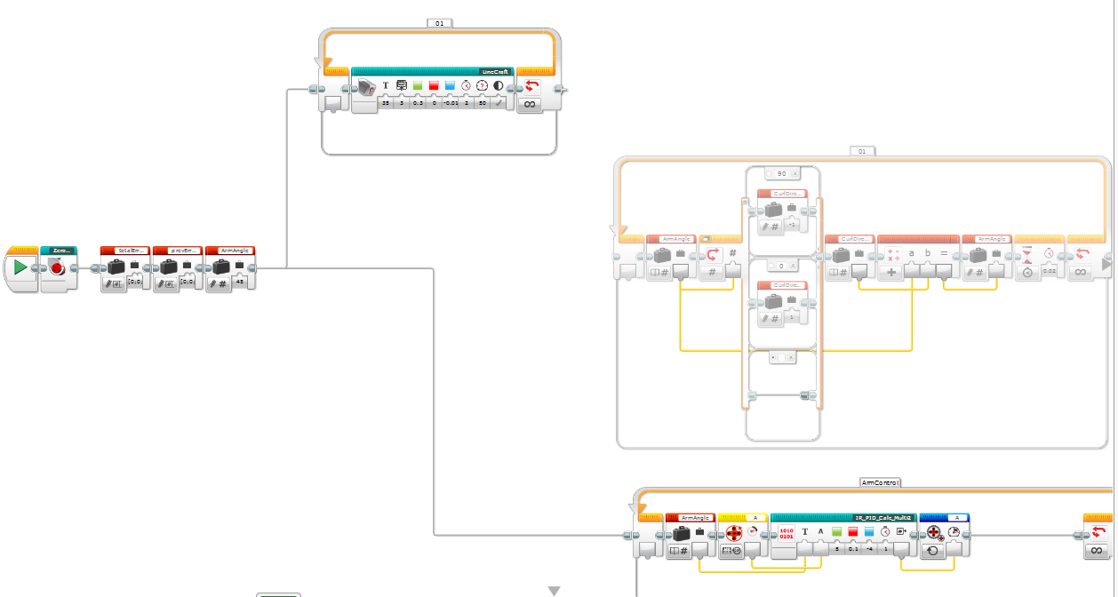
PIDtest

Slide 30
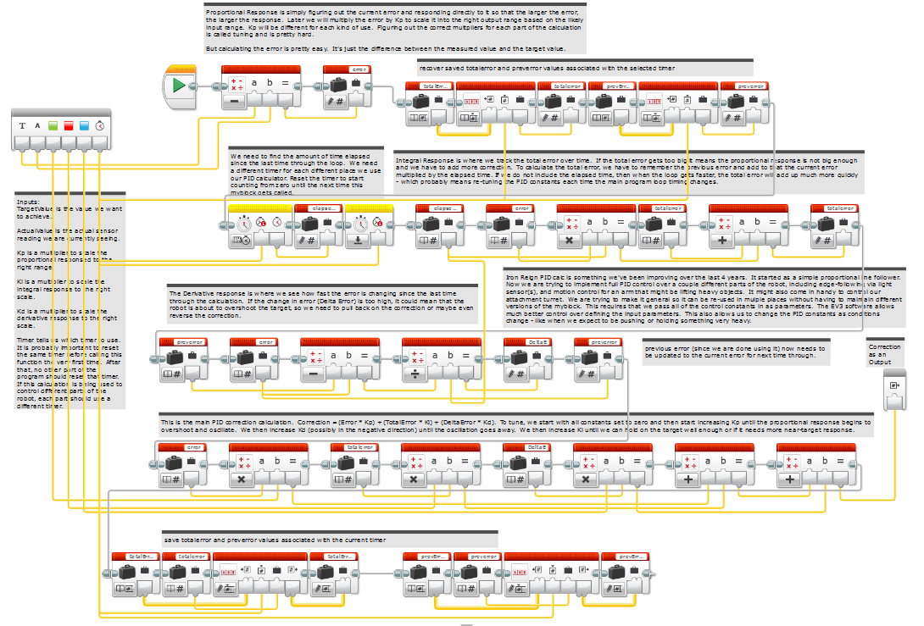
IR_PID_Calc_Multi

Slide 31
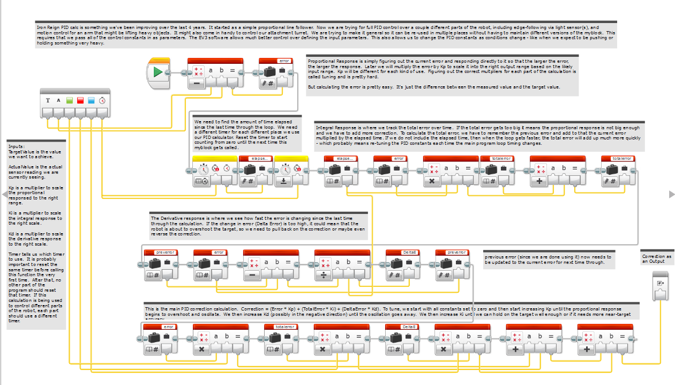
IR_PID_Calc

Slide 32
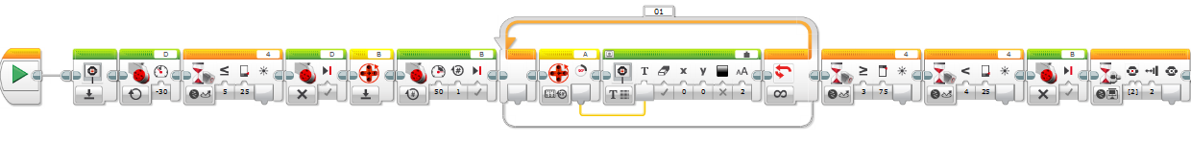
Stage_2

Slide 33
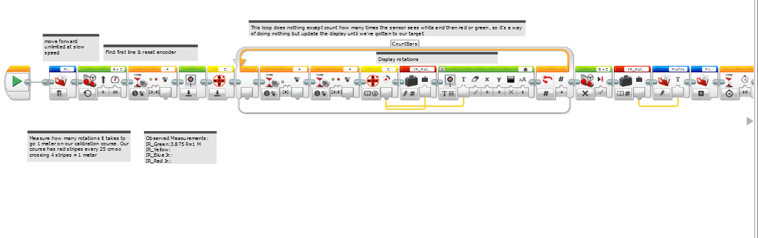
StraightTravel

Slide 34
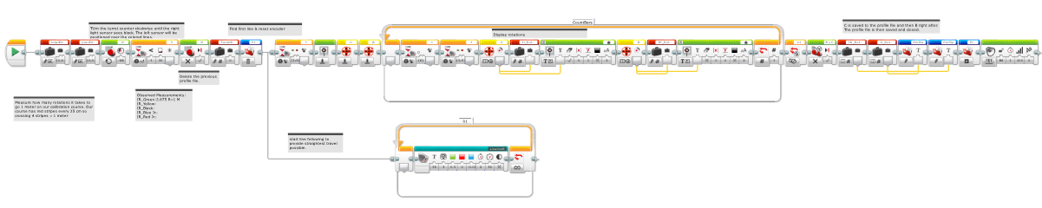
StrtOdomCalcy

Slide 35
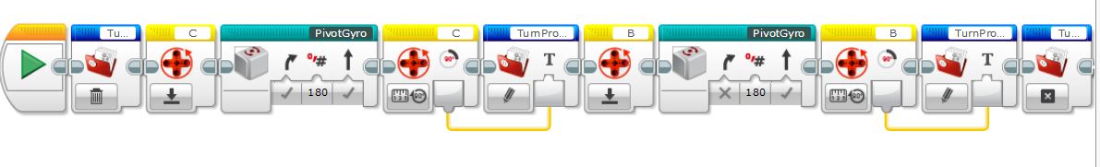
OdomPivot10

Slide 36
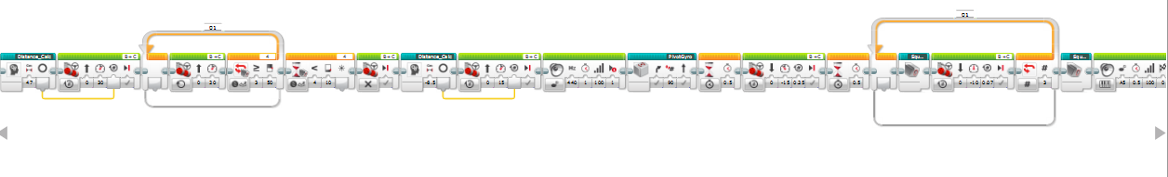
SquarSequence

Slide 37
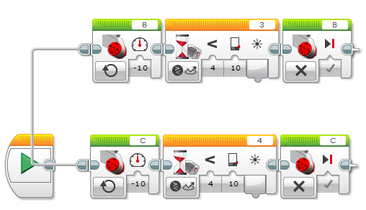
SquareSequenceRev

Slide 38
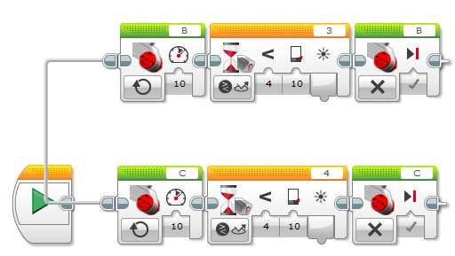
SquareSequence

Slide 39
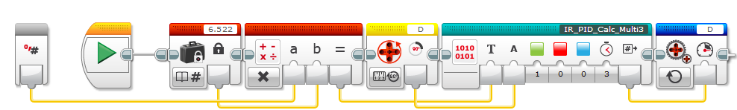
PosTurret

Slide 40
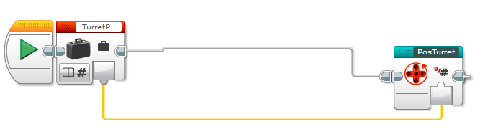
TurretDemo

Slide 41
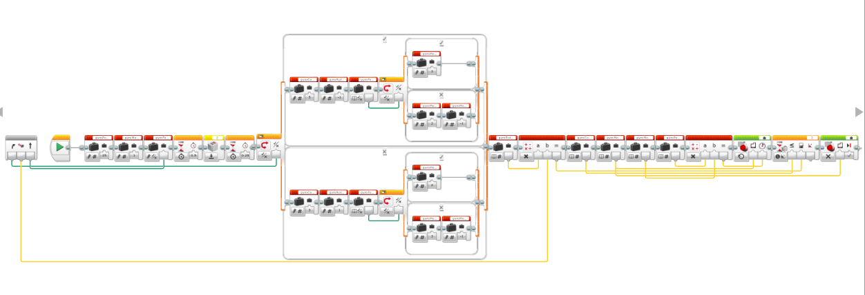
PivotGyro

Slide 42
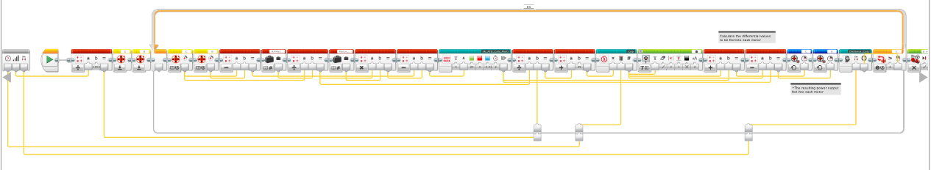
SupaStraight

Slide 43
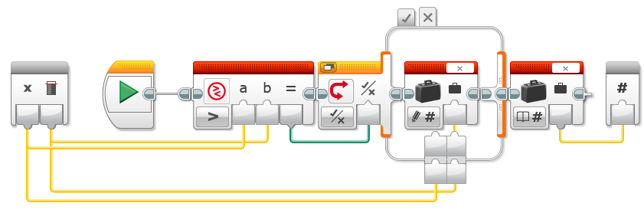
Cap

Slide 44
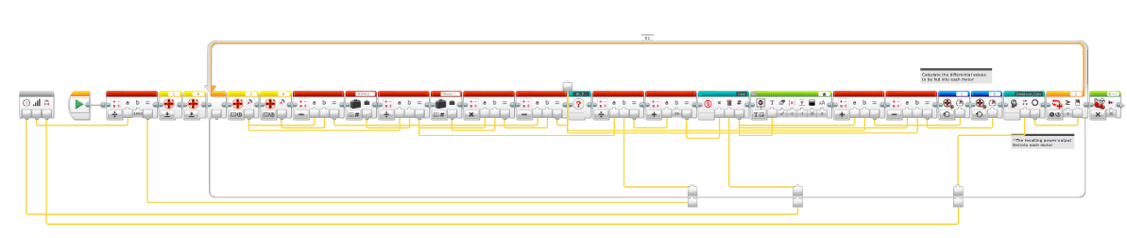
SupaStraightCoast

Slide 45
SupaStraightNoLimits

Slide 46
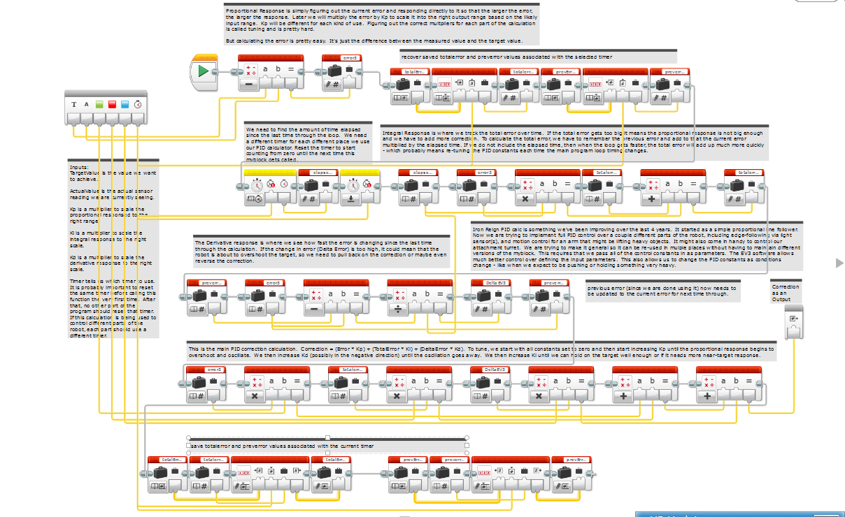
IR_PID_Calc_Multi3

Slide 47
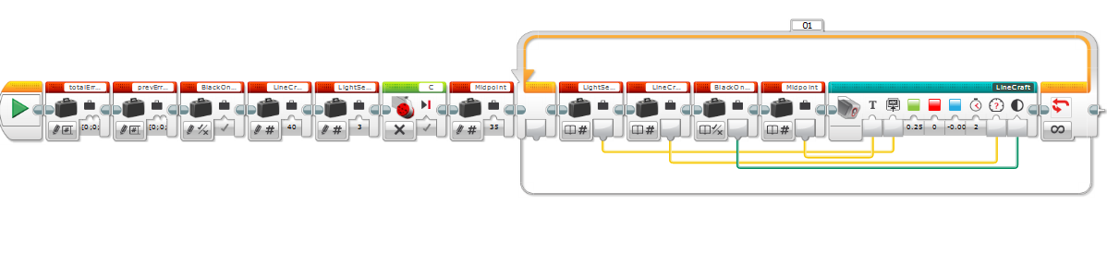
LineCraft8

Slide 48
Game Programs

Slide 49
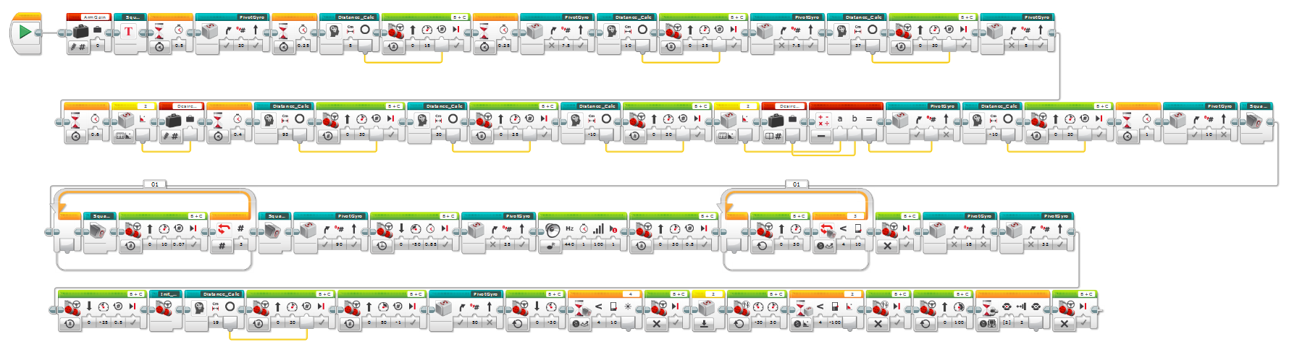
MegaRun

Slide 50
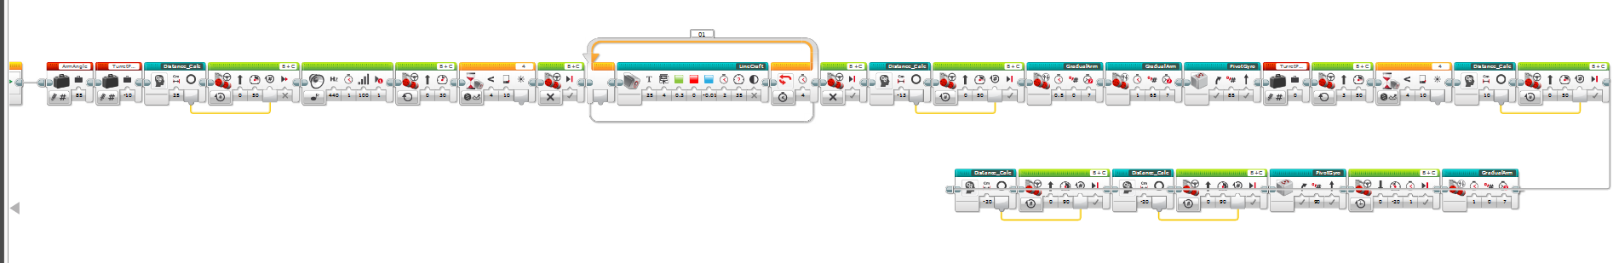
Runabout

Slide 51
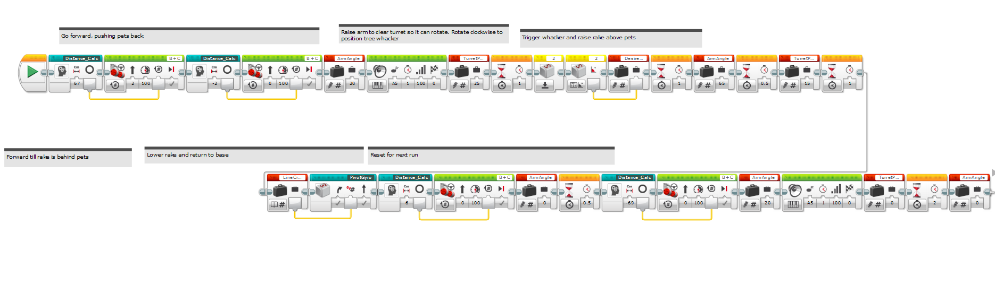
Doge

Slide 52
Plane

